Slide 1
University of Toronto Data Visualization Boot Camp: FACTORS IMPACTING CONSUMER SPENDING ON AIRBNB IN THE UNITED STATES
Alyshia Kiczma
Arshdeep Khurana
Nasir Qadri
Kaylyn Valdez-Scott

Slide 2
Project description
Our team was hired by Airbnb to analyze various factors and determine any impacts on customer spending

Slide 3
Questions of Interest
Do different neighbourhoods or neighbourhood groups differ in price?
Does the verification of the host impact the price of the listing?
Does Construction year of the property impact the price of the listing?
How prevalent are cancellation policies and do they impact the listing?
Do number of reviews differ based on room type? Does the review rate number impact the price?

Slide 4
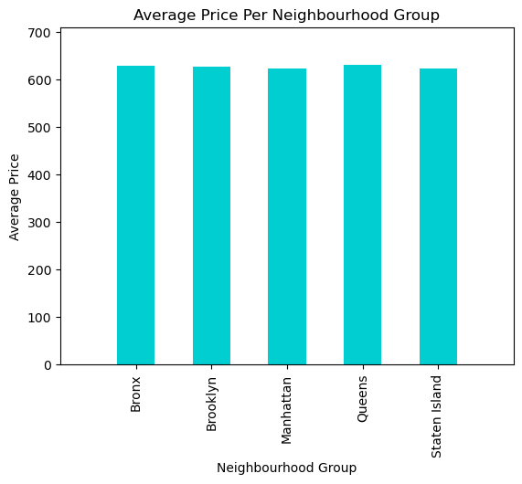
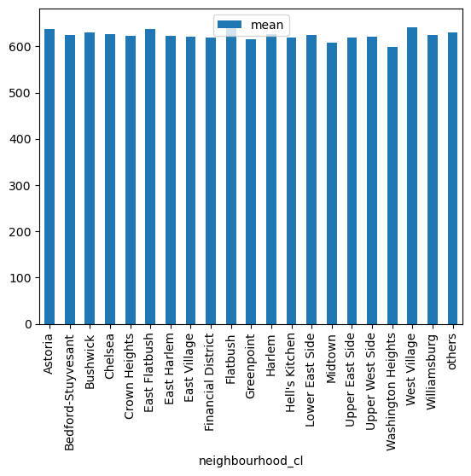
Do different neighbourhoods or neighbourhood groups differ in price?
Neighbourhood Group | Price ($)
Bronx | 629.73
Brooklyn | 627.21
Manhattan | 623.09
Queens | 630.68
Staten Island | 623.01

Slide 5
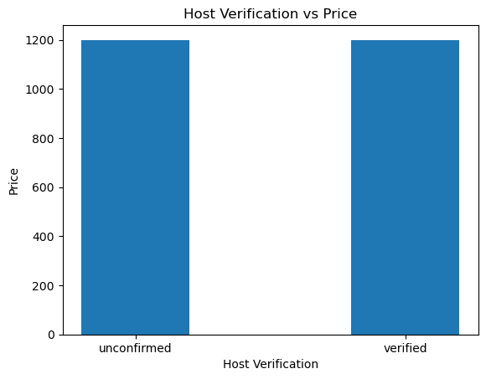
Does having a verified host impact price?

Slide 6
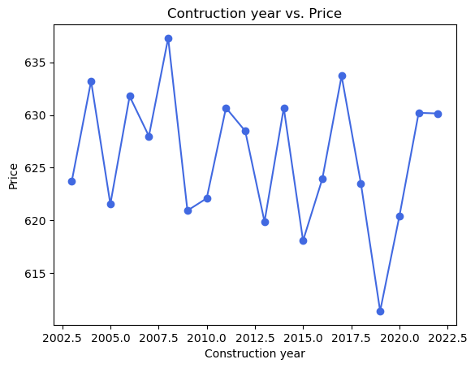
Does construction year impact price
Construction Year Median | Construction Year Variance | Construction Year Std Dev | Construction Year SEM | Construction Year Max | Construction Year Min
2012 | 34.373862 | 5.862923 | 0.121933 | 2022 | 2003
2013 | 33.145421 | 5.757206 | 0.030689 | 2022 | 2003
2012 | 32.878289 | 5.733959 | 0.03058 | 2022 | 2003
2012 | 34.023267 | 5.832947 | 0.054874 | 2022 | 2003
2011 | 34.271451 | 5.854182 | 0.202592 | 2022 | 2003
2010 | NaN | NaN | NaN | 2010 | 2010

Slide 7
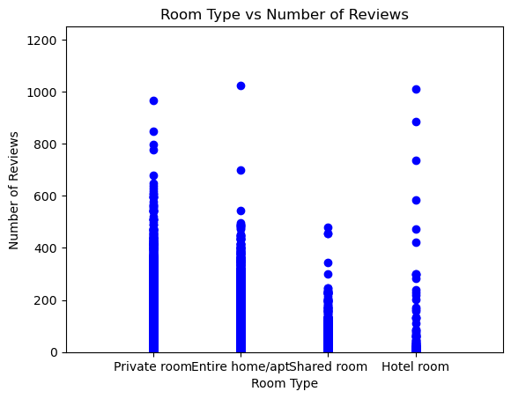
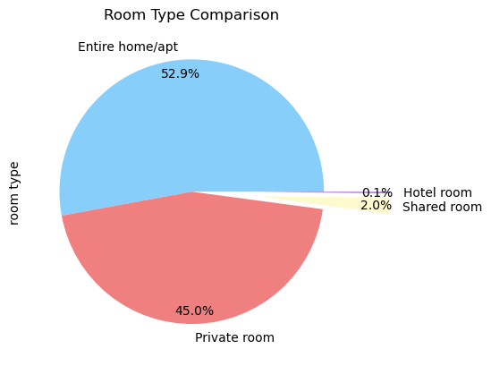
Room Type

Slide 8
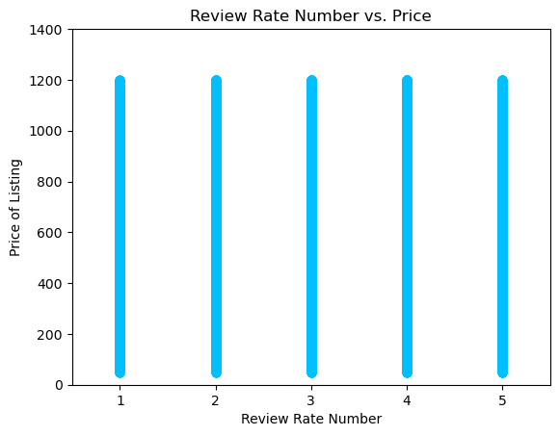
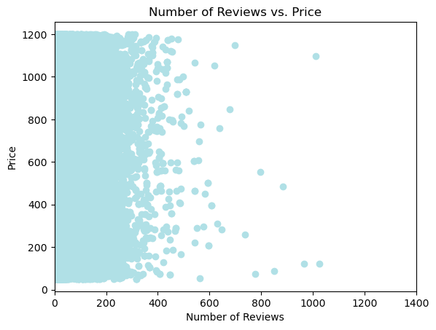
do number of reviews differ based on room type? Does the review rate number impact the price?

Slide 9
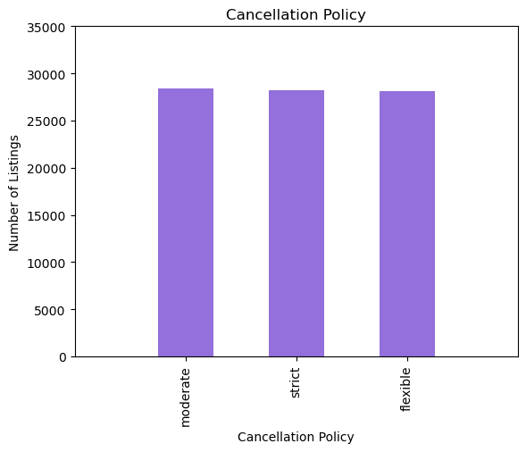
How prevalent is a cancellation policy?

Slide 10
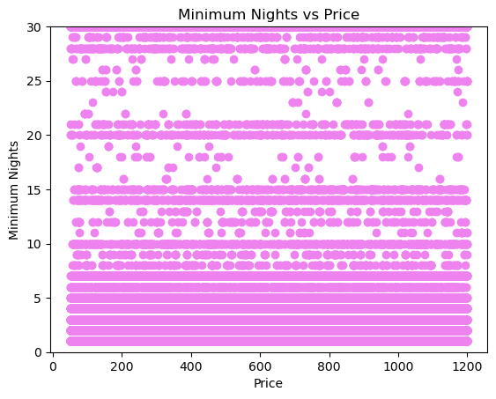
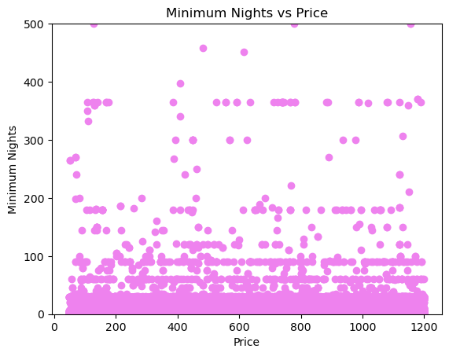
Do Minimum Nights of a Listing impact the price

